Slide 1


Instructor Resources
Chapter 10 Figures
Cover photo: BeautyStock – stock.adobe.com.

Slide 2
Chapter 10
Performance

Slide 3
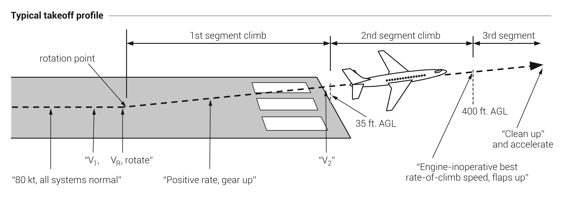
(continued)
FIGURE 10.1
(1 of 2)
Takeoff and landing V-speeds.

Slide 4
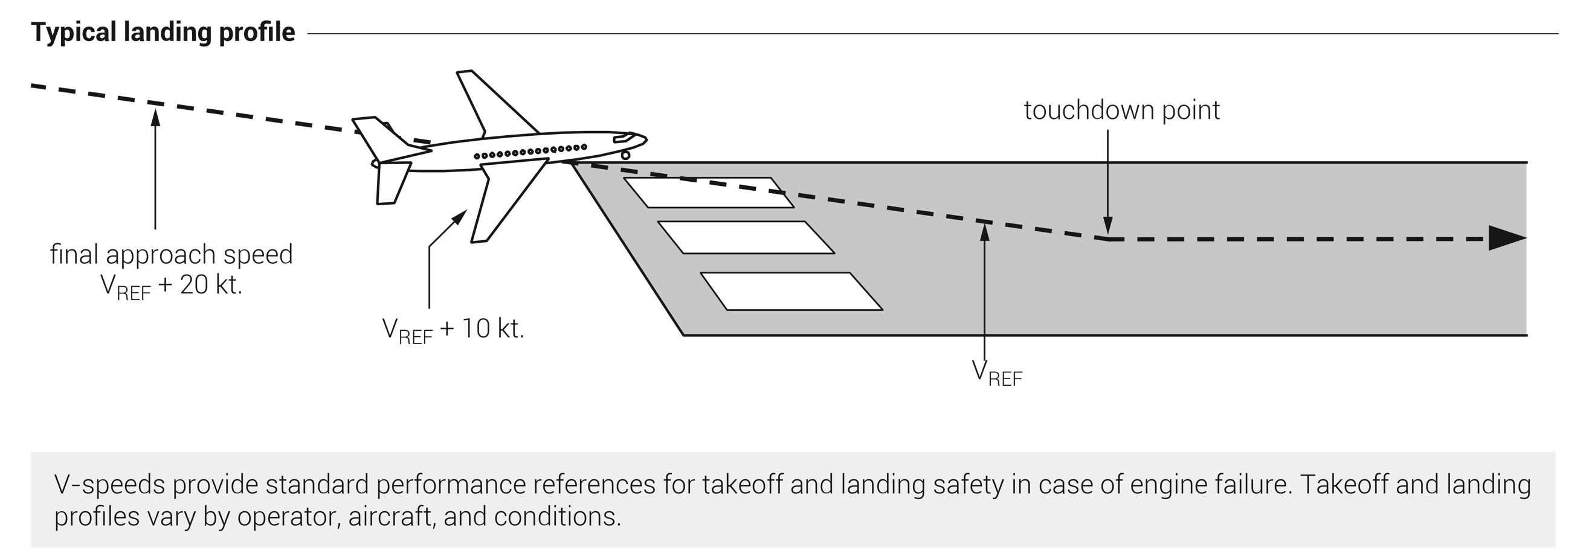
FIGURE 10.1
(2 of 2)
Takeoff and landing V-speeds.

Slide 5
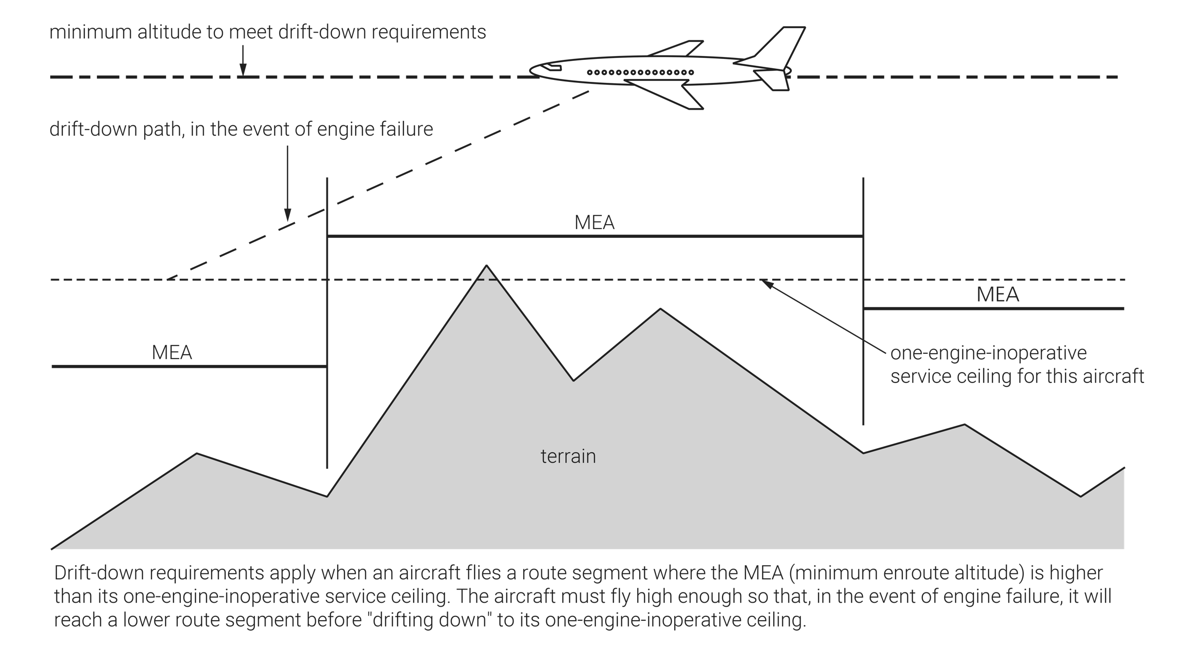
FIGURE 10.2
Engine-out drift-down requirements.

Slide 6
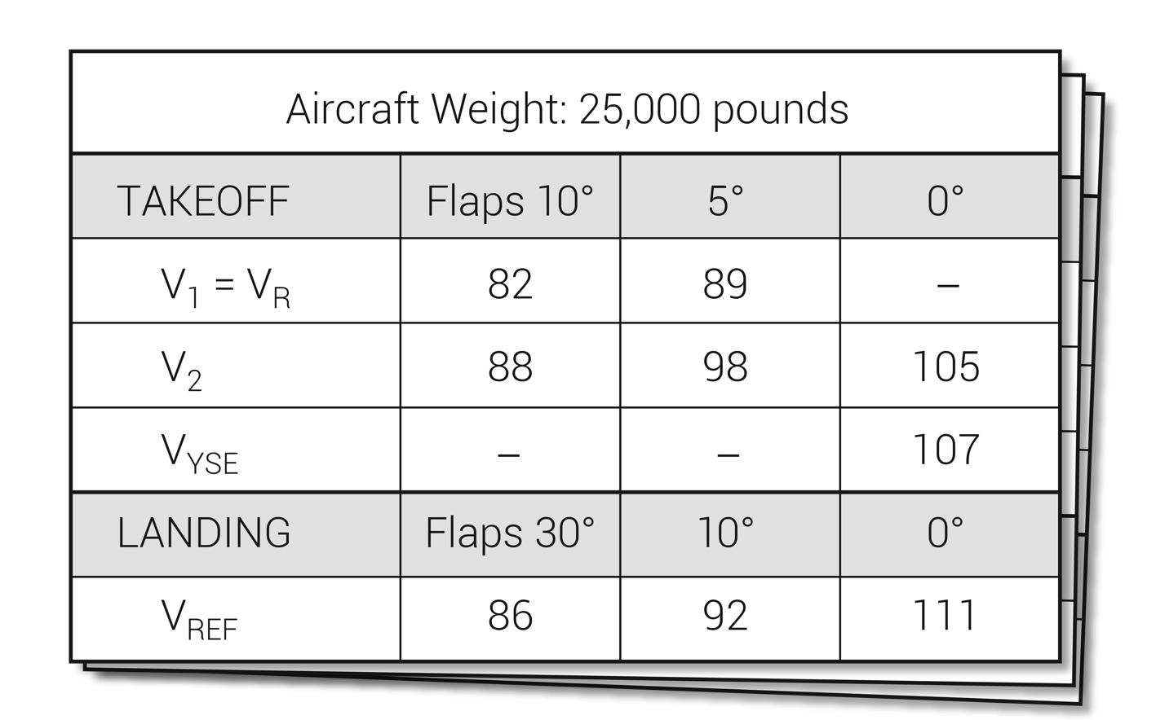
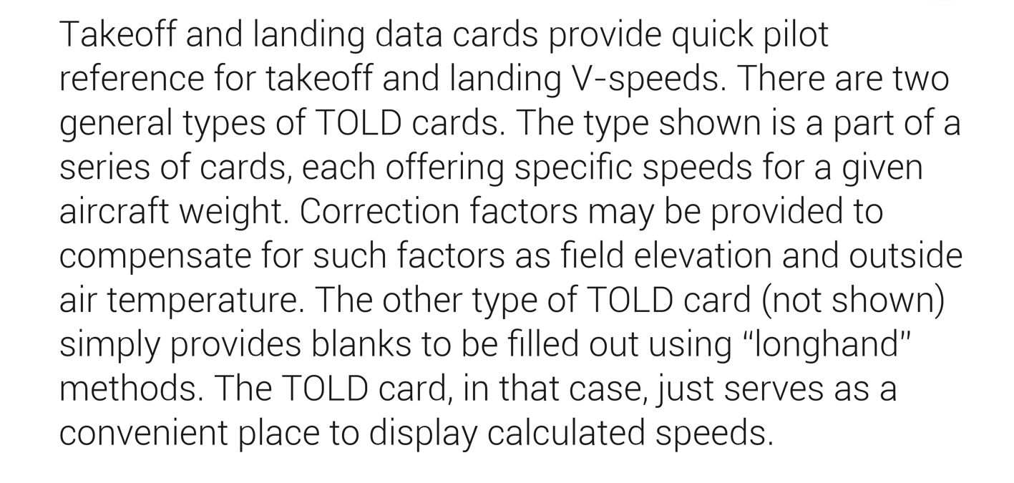
FIGURE 10.3
Takeoff and landing data card (TOLD card).

Slide 7
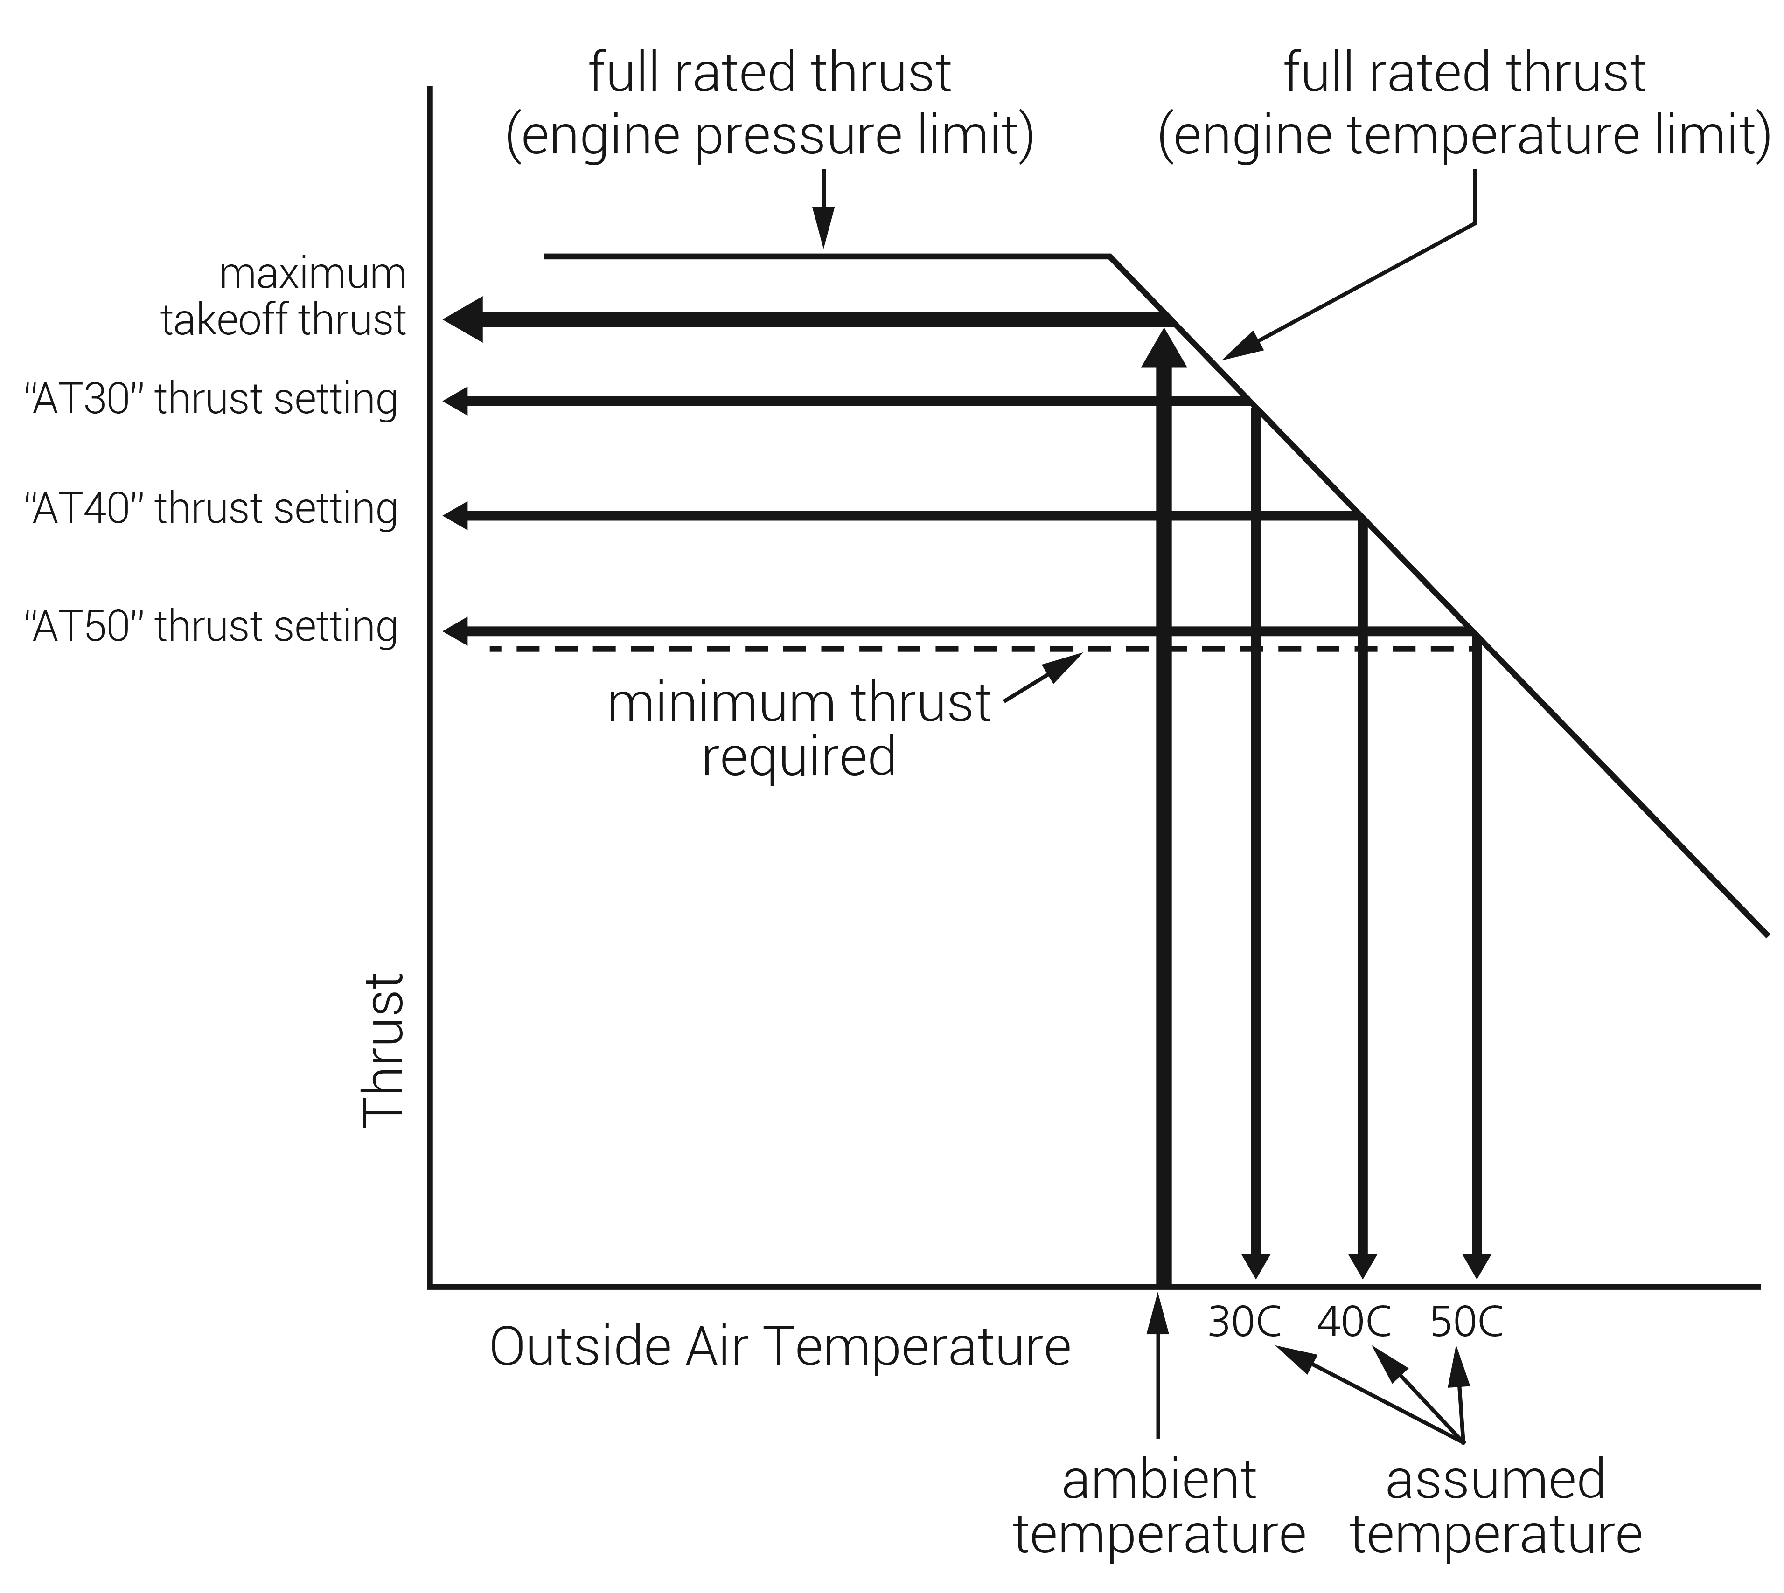
FIGURE 10.4
Temperature-derived reduced takeoff thrust.

Slide 8
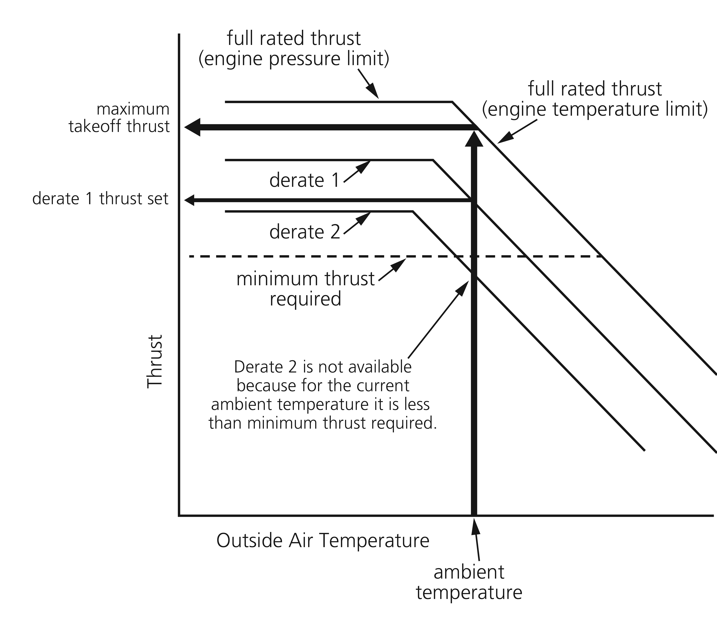
FIGURE 10.5
Derated thrust.

Slide 9
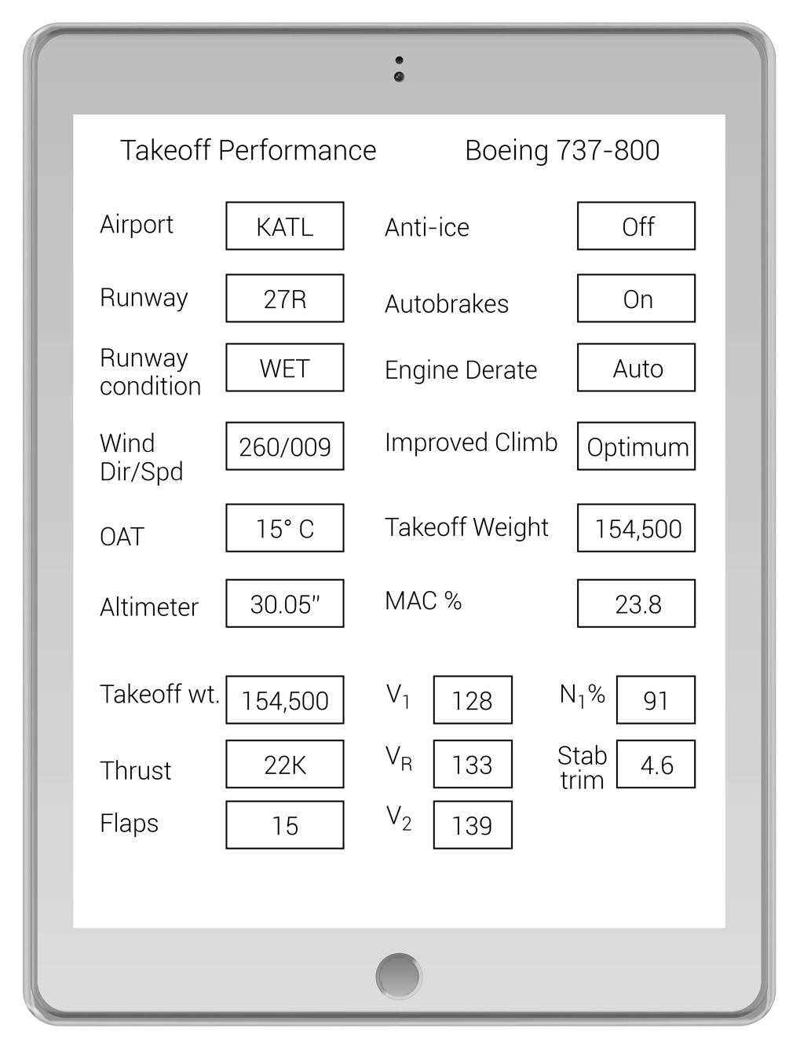
FIGURE 10.6
Performance calculations on an electronic device.

Slide 10
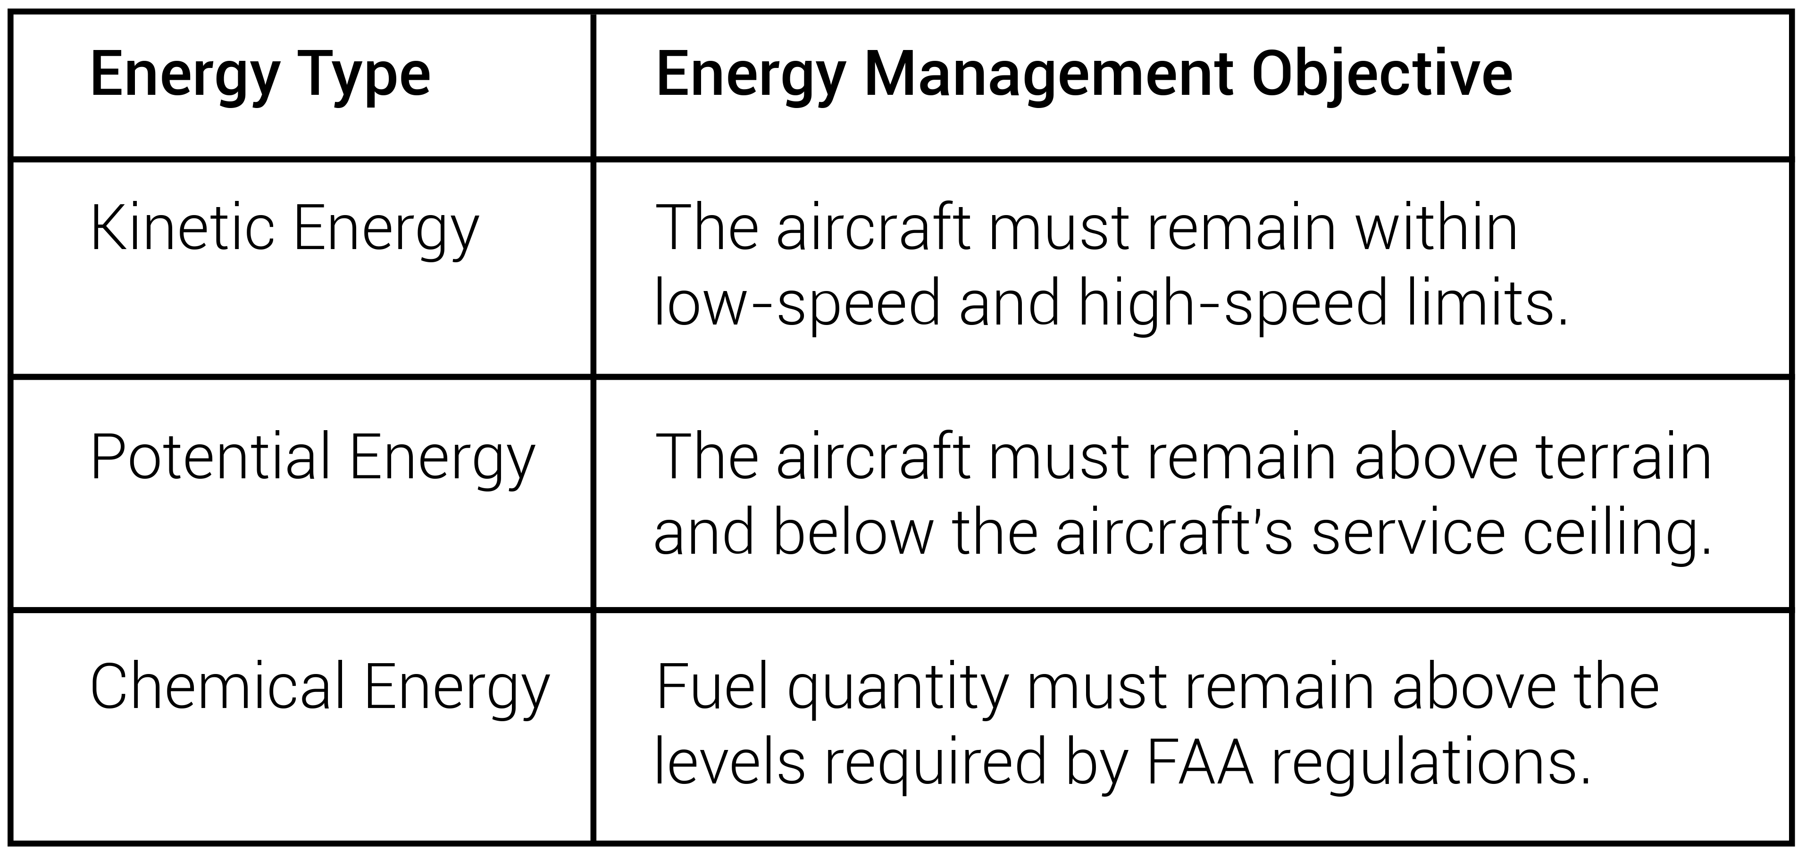
FIGURE 10.7
Energy management.

Slide 11
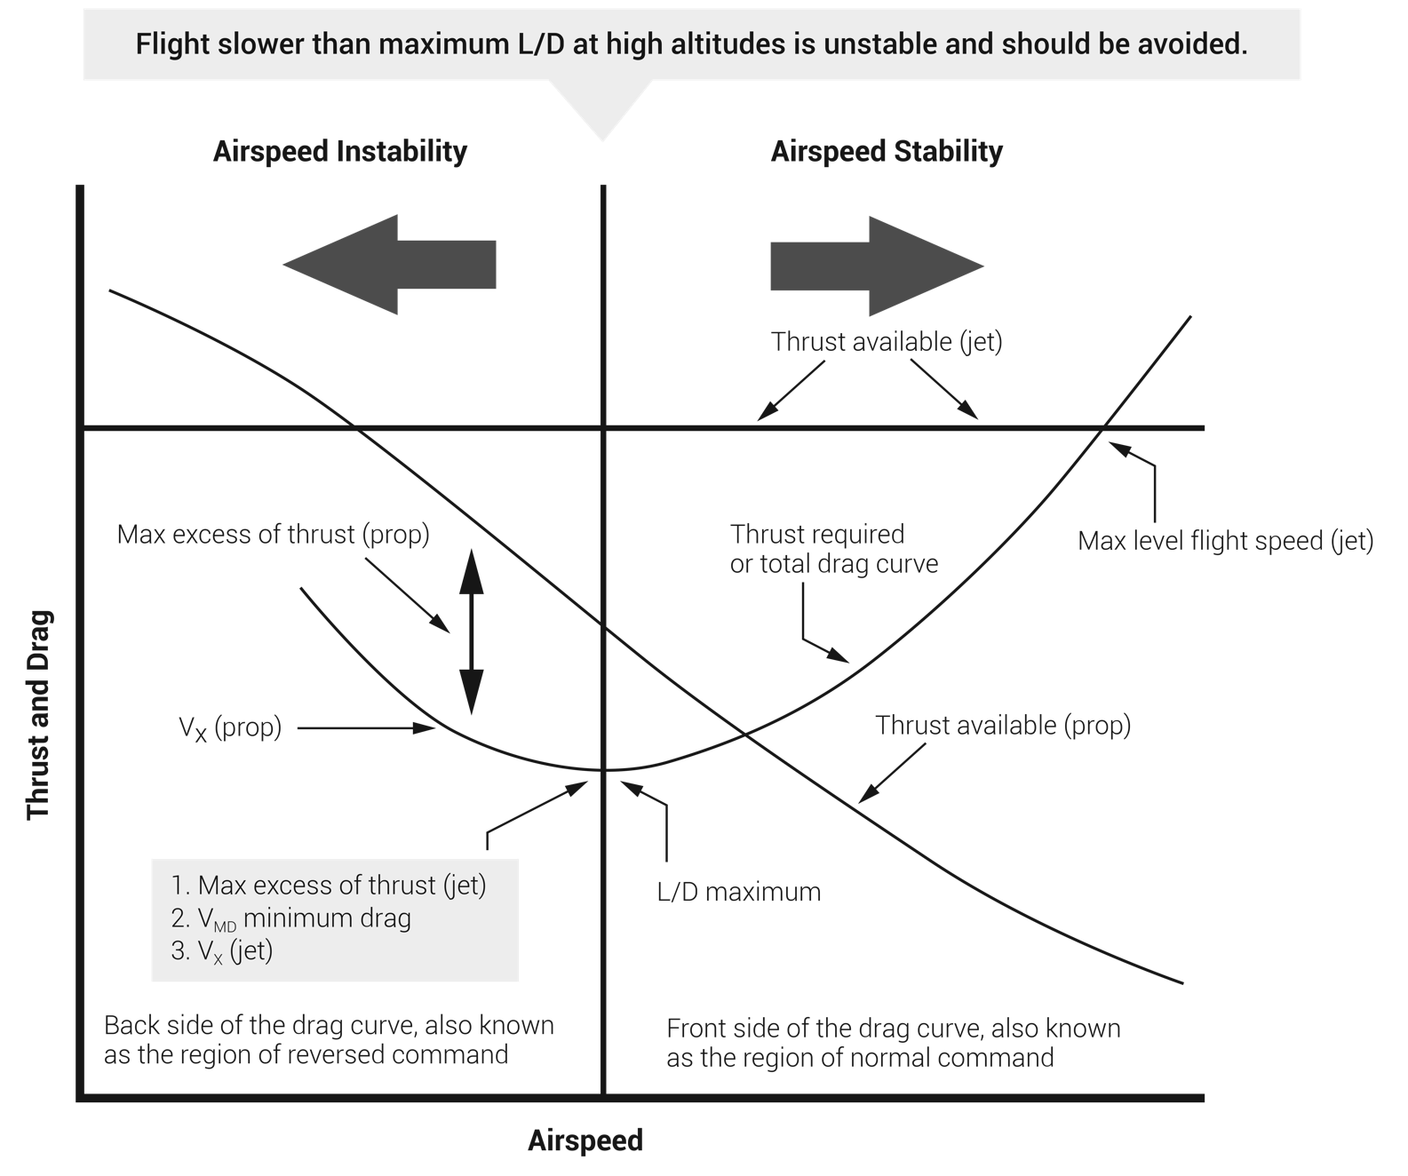
FIGURE 10.8
Thrust and drag versus airspeed in level flight.

Slide 12
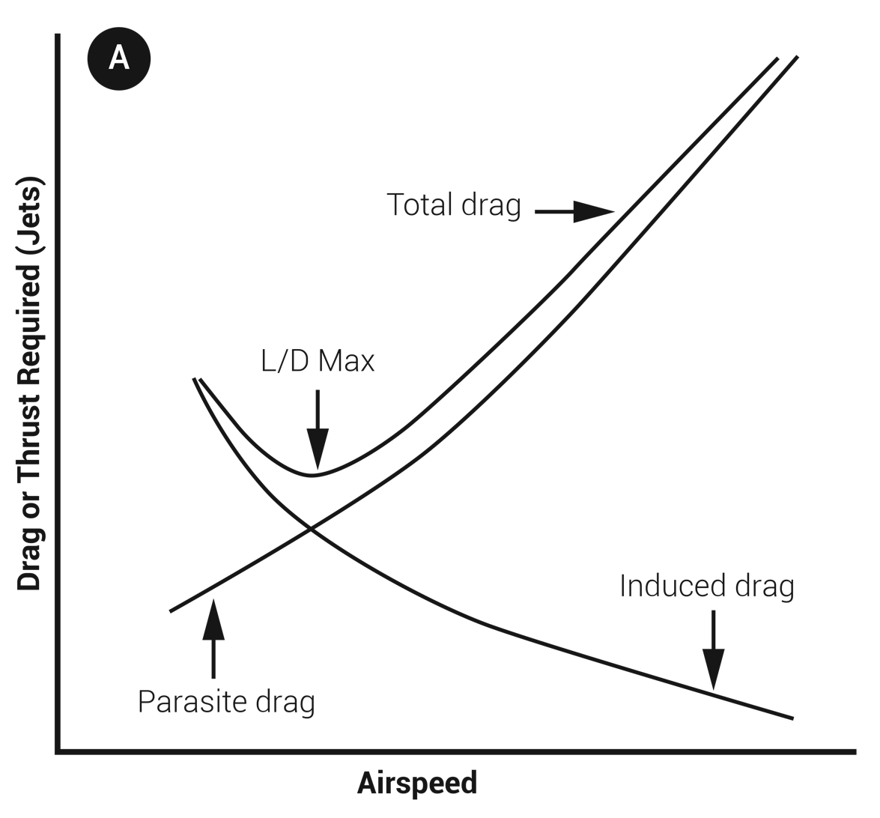
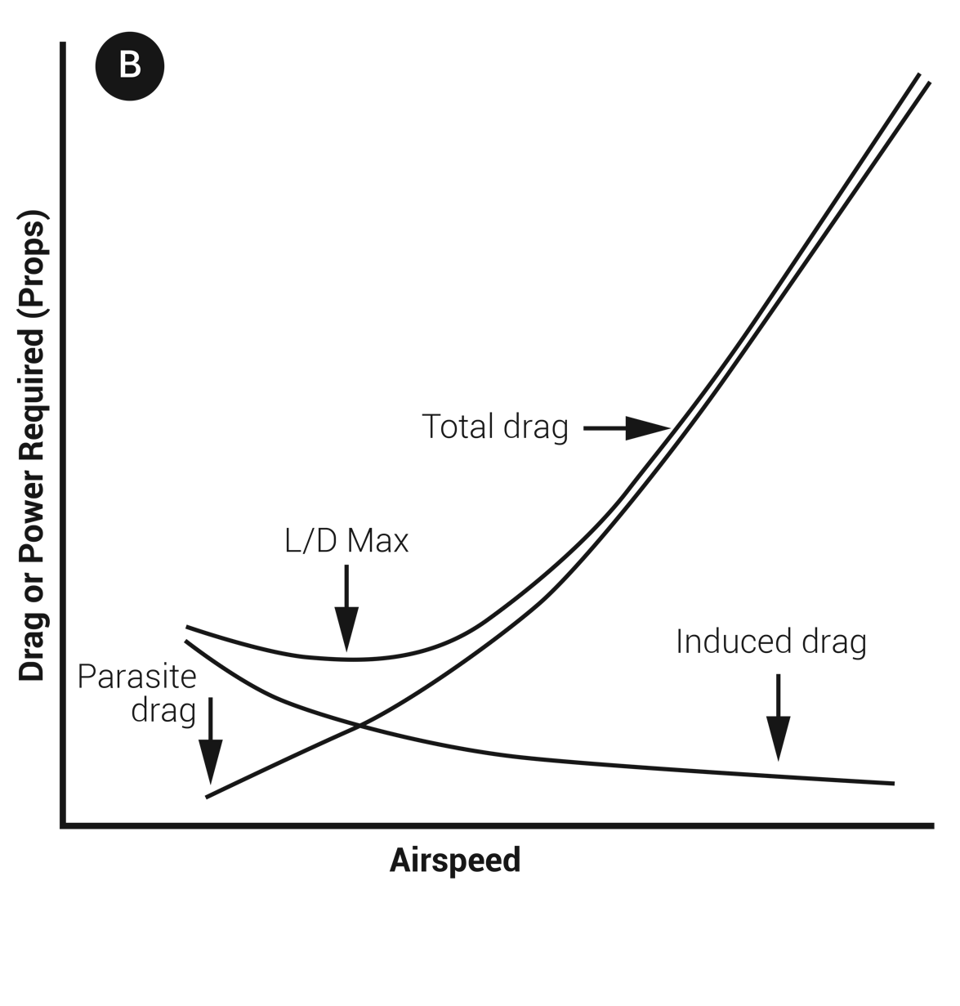
FIGURE 10.9
Total drag curve comparison: (A) jet-powered aircraft and
(B) propeller aircraft.

Slide 13
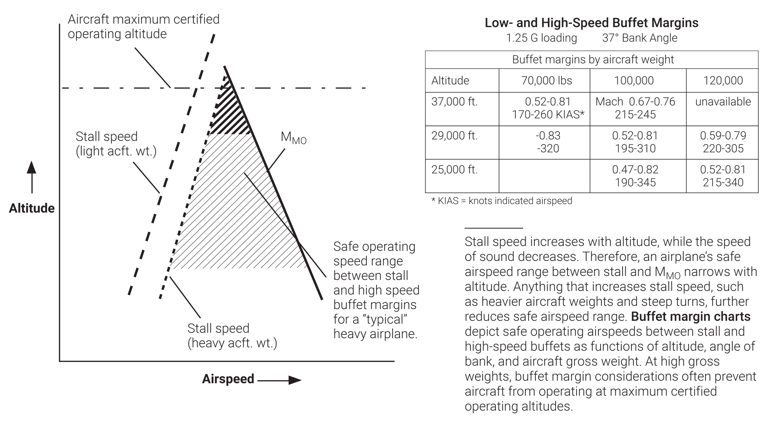
FIGURE 10.10
Stall speed versus altitude.

Slide 14
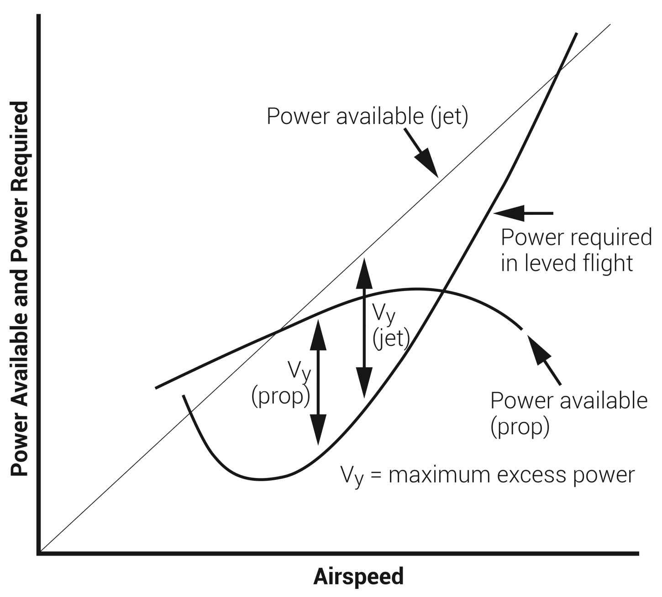
FIGURE 10.11
Finding the maximum rate of climb airspeed.
(Source: Aerodynamics for Naval Aviators.)

Slide 15
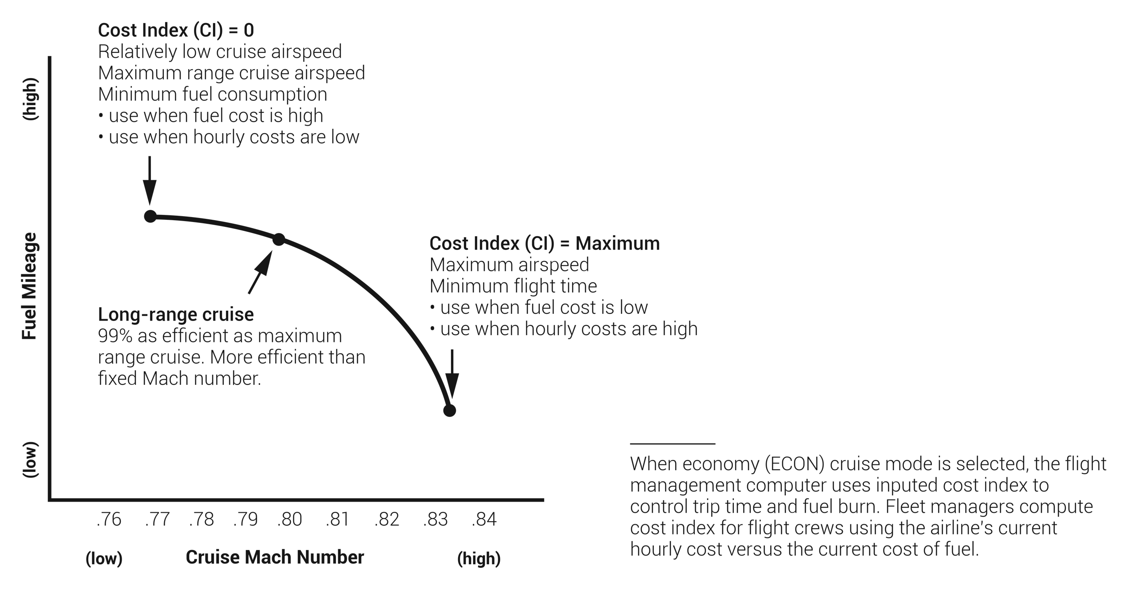
FIGURE 10.12
Cost Index (CI) Economy Cruise.

Slide 16
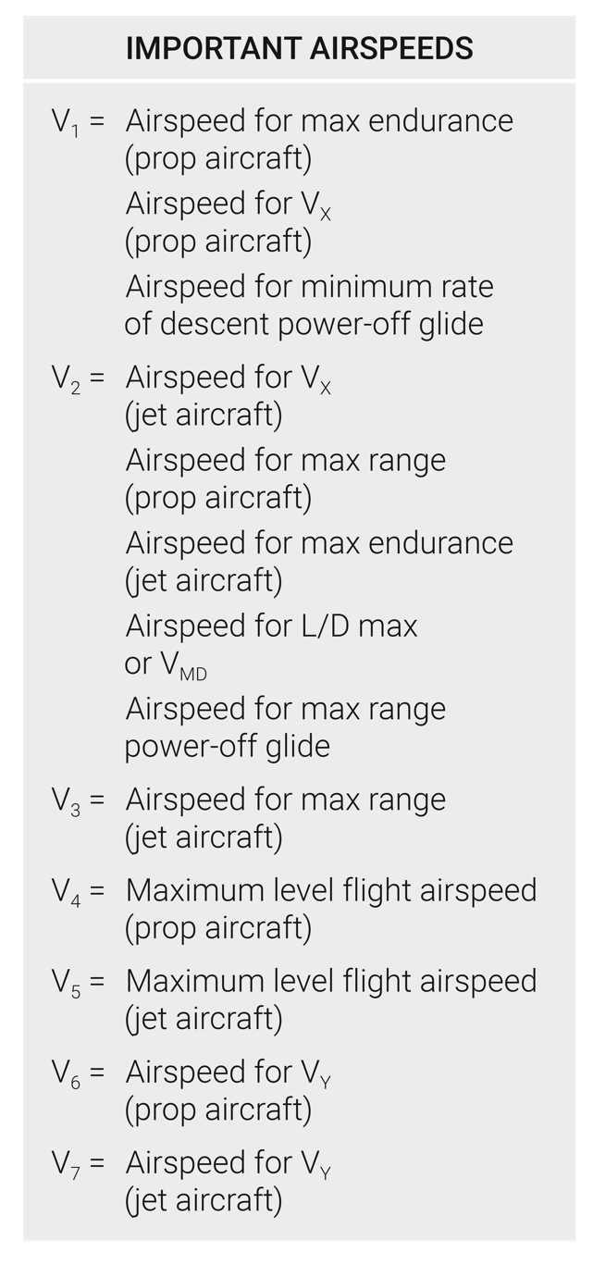
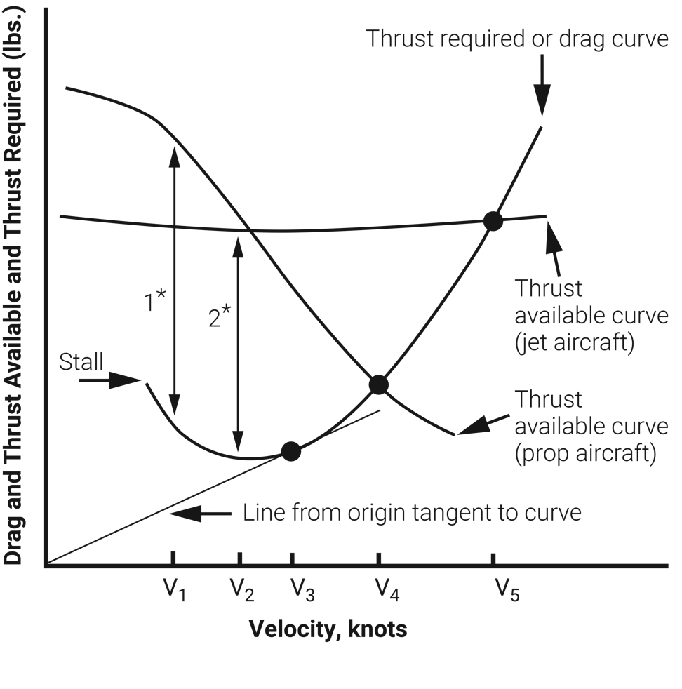
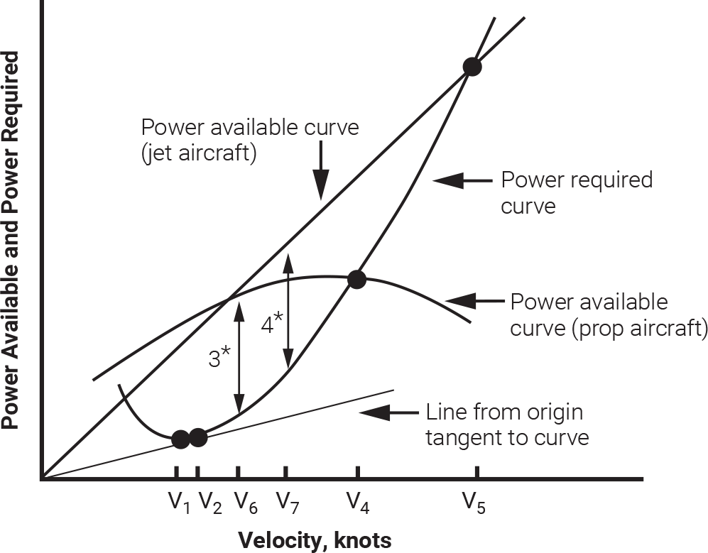
FIGURE 10.13
Airplane performance summary.

